Slide 1
Social Network in Bible
SYSM 6302
Group 2
Deepthy Ann Thomas - dat150130
Emy Emmanuel - exe150030

Slide 2
Agenda
Motivation
Description of The Network
Centrality Measures
Degree Distribution And Power Law
Friendship Paradox
Modularity
Large Component
Findings from the Network

Slide 3

Motivation
Data visualization of the Bible as a classic distribution visualization, which shows where various people and places occur in the text.
http://www.chrisharrison.net/index.php/Visualizations/BibleViz
Assistant Professor
Human-Computer Interaction
Carnegie Mellon University

Slide 4
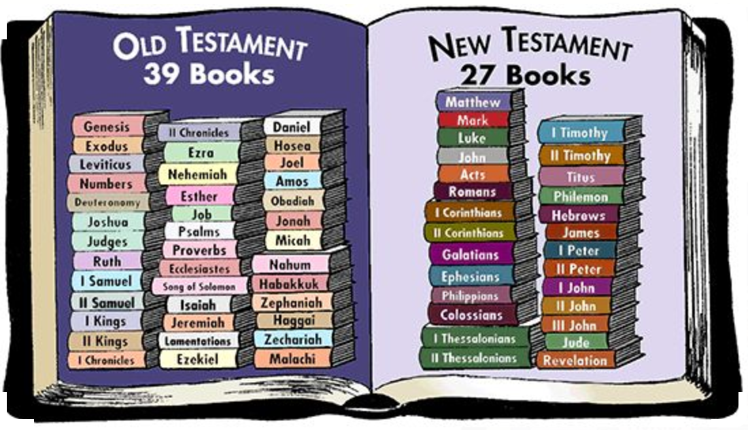
Bible

Slide 5
Network
Nodes : Nouns(Characters & Places) from the Old Testament
Edges : Two nouns appear in the same verse.
Weight : Number of times two nouns appear in the same verse
#nodes - 895
#edges- 2857

Slide 6
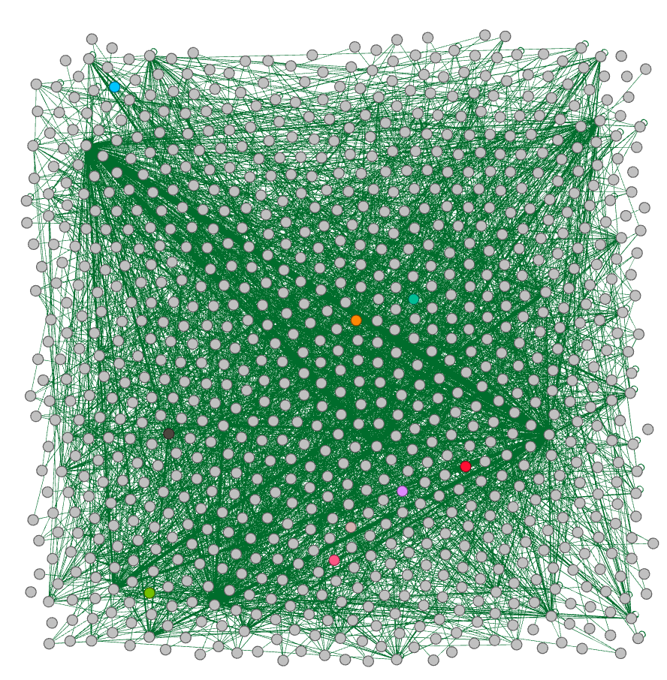
Network Description
Weighted
Undirected
Diameter - 25
Avg clustering - 0.590
Adam
Image Source:
bible.gml graph visualization using Gephi

Slide 7
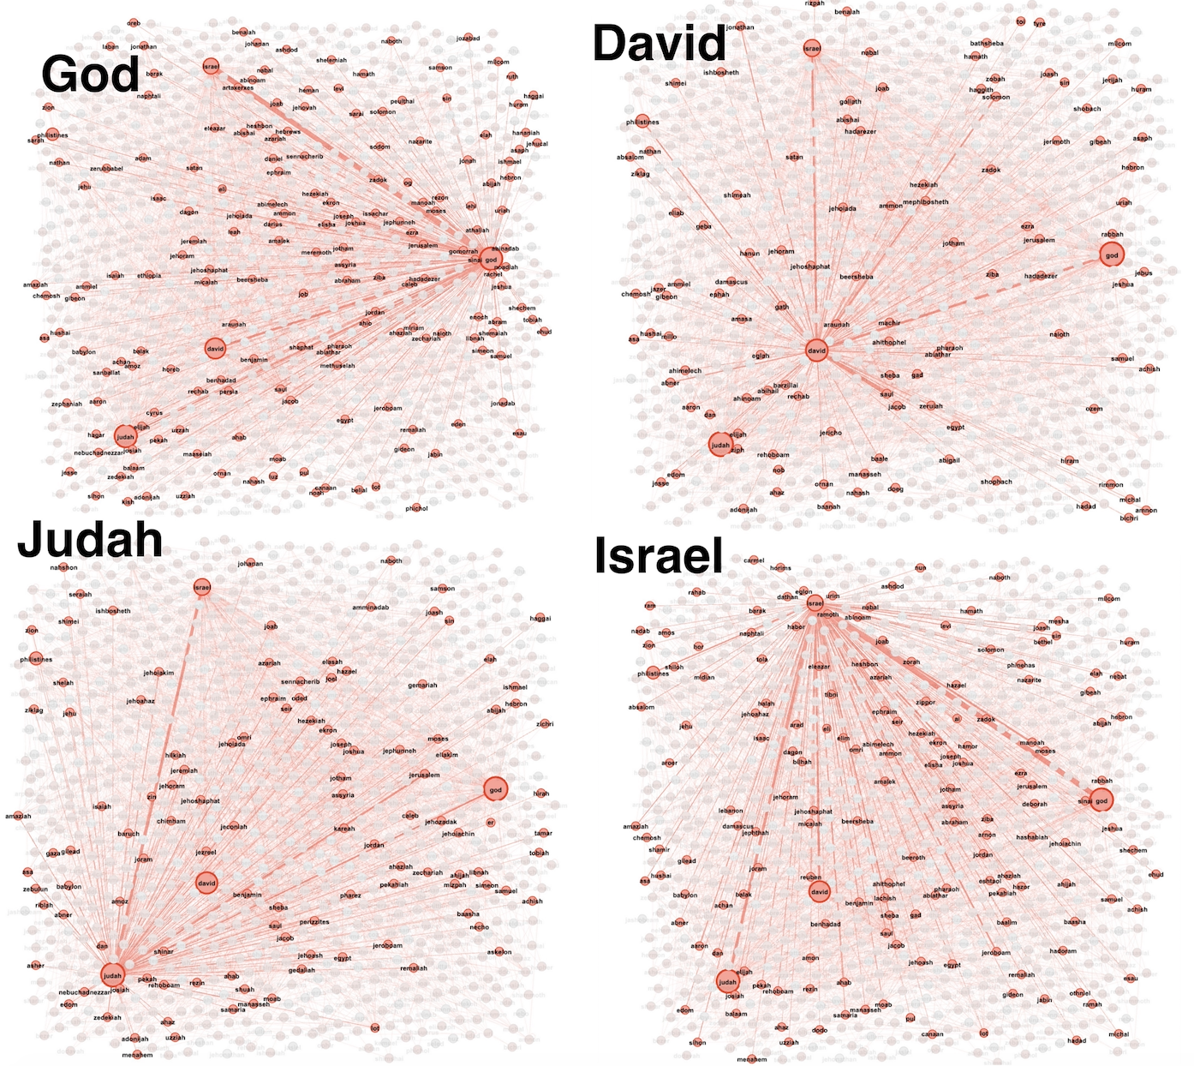
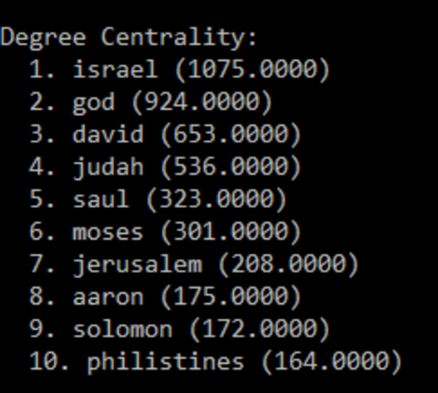
Image Source:
bible.gml graph visualization using Gephi
Notes:
This is the list of the first ten nodes in the decreasing order of their degree centralities. On the right are the visualizations centered on the first four nodes with the highest centralities. This was done with a tool called gephi. When we select a particular node, all the edges it is a part of is highlighted so that we get an idea of its connectivity.

Slide 8
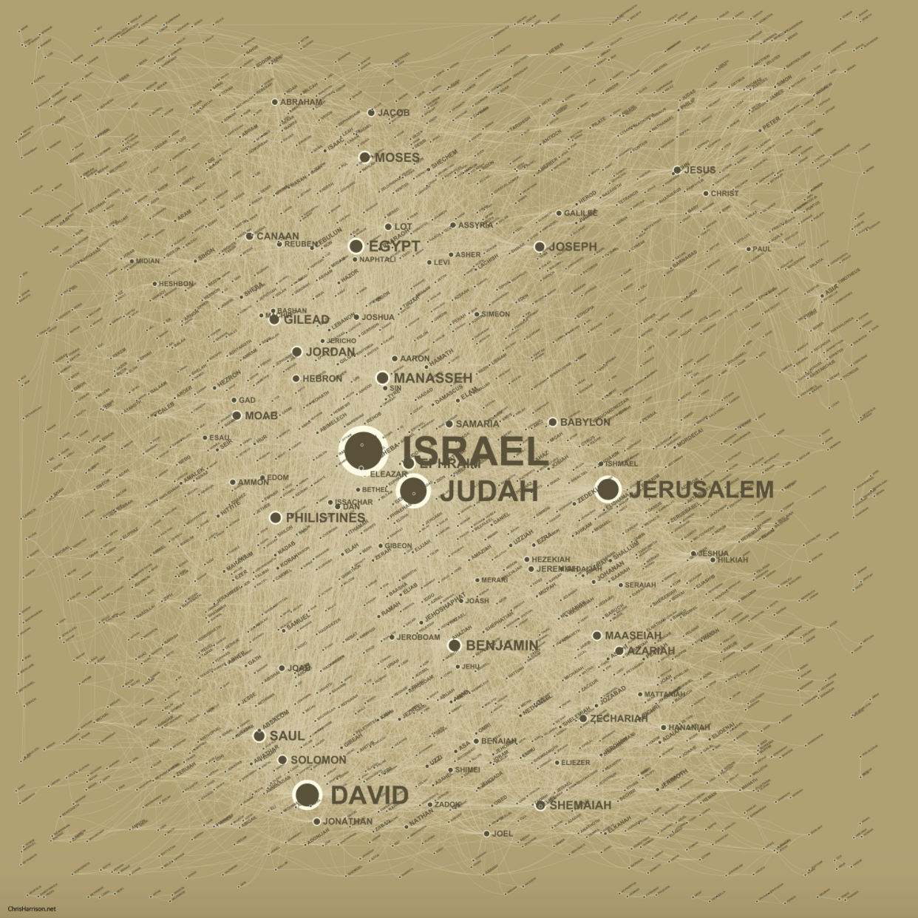
Centrality Measures
Degree Centrality
Most happening place during the Old Testament :
Israel (1075.00)
Judah (536.00)
Jerusalem(208.00)
Philistines(164.00)
Most popular/ influential people during the old testament:
God (924.00)
David(653.00)
Saul(323.00)
Moses(301.00)
Image source: http://chrisharrison.net/projects/bibleviz/BibleNetworkmediumOrig.jpg
Notes:
Israel is the place with the highest centrality and it is as expected since majority of the events in the old testament are centered here. In terms of people, God has the highest centrality which is not surprising. The visualization on the right is the one obtained by Professor Chris Harrison for his network and we can see that the results are similar.

Slide 9
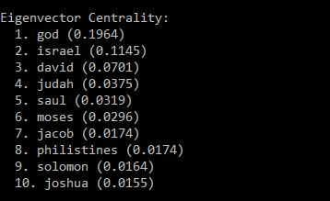
Eigenvector Centrality
Notes:
On calculating the eigenvector centrality for the first ten nodes we see that there is significant difference when compared to the degree centralities, but the nodes which come in both the lists are mostly the same except for a few which implies that including the importance of the neighbors in the calculations have more effect for some nodes than for others.

Slide 10
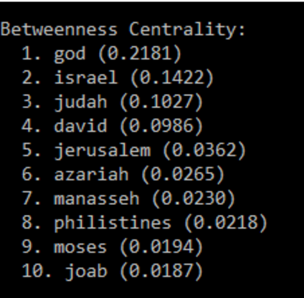
Betweenness Centrality
Top candidates are God and Israel, which is not surprising.
Notes:
Again, when we calculate betweenness centrality, the highest values are for Israel and God which is not surprising.

Slide 11
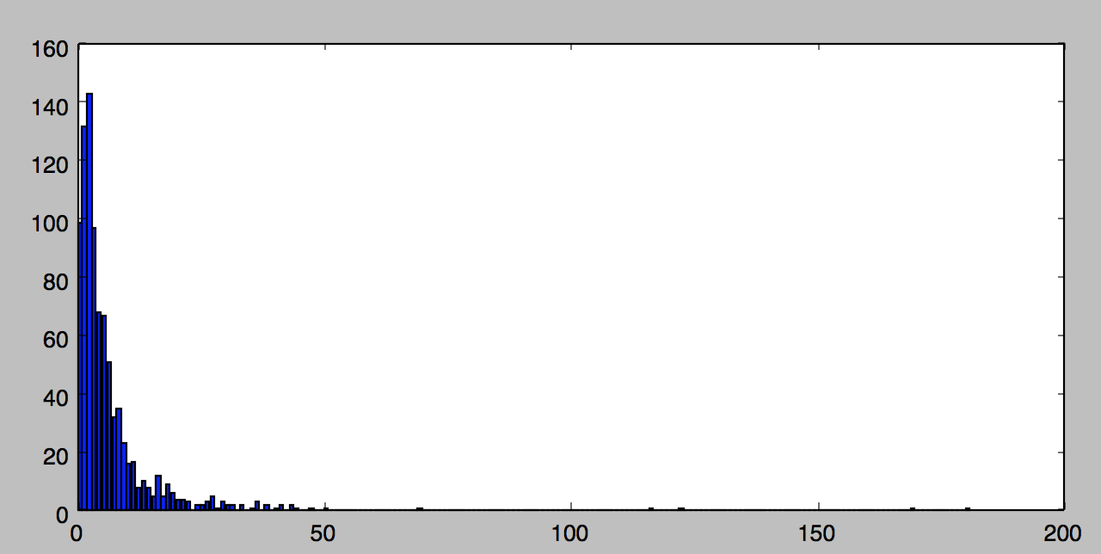
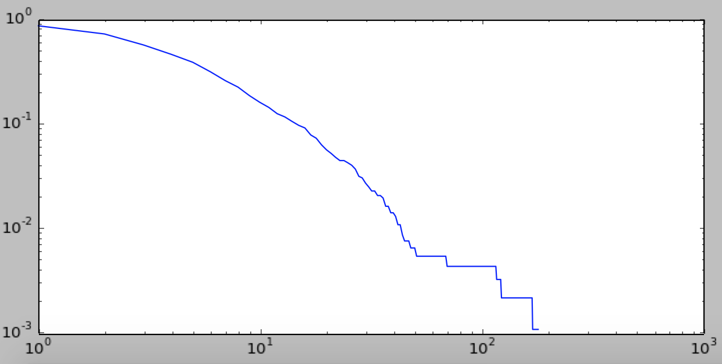
Degree Distribution & Power Law
Right- Skewed Degree Distribution
Very few high degree nodes.
Presence of Hubs.
Power Law kmin = 3
alpha = 1.97
Notes:
The degree distribution is right skewed with very few high degree nodes.
The network seems to kind of obey the power law with kmin = 3.

Slide 12
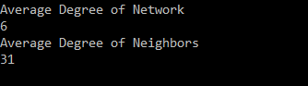
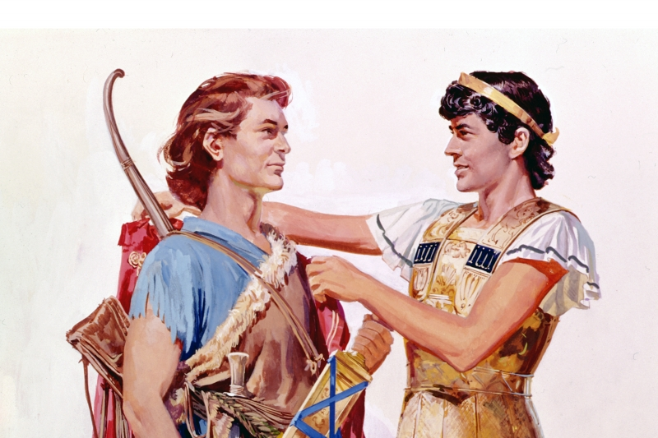
Friendship Paradox
Friendship in the Old Testament - David & Jonathan
Notes:
The friendship paradox hold for this network since the average degree of nodes in the network is smaller than the average degree of their neighbors

Slide 13
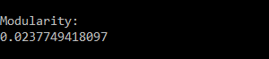
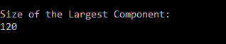
Other features
Modularity:
Split into two groups : People & Places.
Assortative Mixing
Largest Component:
Notes:
We calculated the modularity by splitting the nodes into two groups - People and Places.
This means that in this network, connections between people and places are more prevalent than people - people or place-place connection.

Slide 14
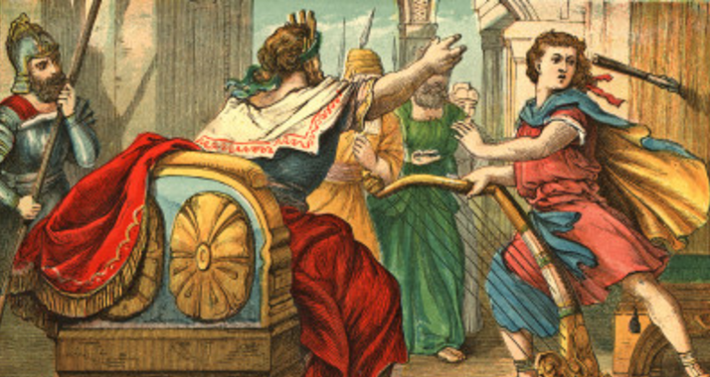
Findings from the Network
God used to frequently appear or be in touch with people from Israel as the edge weight between Israel and God is 131
David and Saul interacted 88 times according to edge weight. This is the highest interaction between two people in the old testament. But this does not imply the relationship was amicable
1 Samuel 18:11 “Saul hurled the spear for he thought, "I will pin David to the wall." But David escaped from his presence twice”

Slide 15
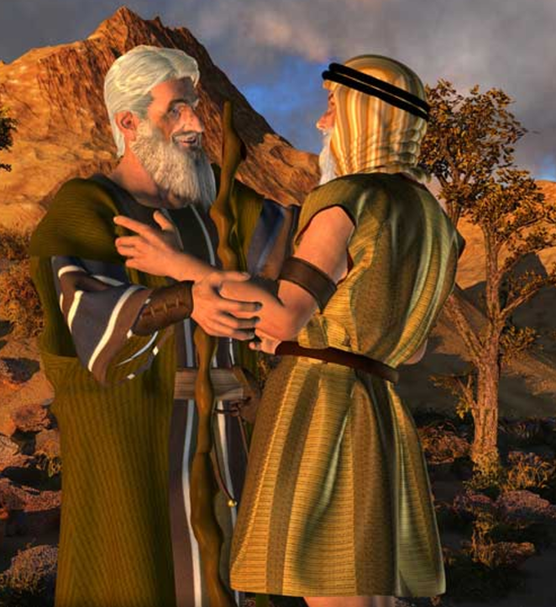
Aaron and Moses who were brothers who lead the people out of Egypt. This on contrary shows the positive relationship between them.
Psalm 77:20 “Thou leadest thy people like a flock by the hand of Moses and Aaron.”

Slide 16

Descrepancies
The occurence of God, multiple times in a verse lead to a self edge between God with the edge weight of 177.
Inference
Edges shows the interaction between two people irrespective of showing the type of relationship between them.
Edges can also represent the frequency of a person being at a particular location

Slide 17

Feedbacks & Questions

Slide 18
Work Cited
http://moreno.ss.uci.edu/names.dat
http://www.chrisharrison.net/index.php/Visualizations/BibleViz
http://www.chrisharrison.net/
https://gephi.org/

